Slide 1

Introduction to R Women in Data 2017
Jelena Ilic & Beth Ashley
Data Scientists
Twitter: @MangoTheCat
Email: info@mango-solutions.com

Slide 2
Agenda
Introduction to R
Reading in datasets
Manipulating datasets
Data visualisations
Bonus material: simple statistics
Introduction to R – Women in Data 2017

Slide 3
Introduction to R
Free, open source implementation of the "S" language
Originally written by Robert Gentleman and Ross Ihaka of the University of Auckland
R has many contributors from all over the world - CRAN is the main public package repository
Over 10,000 packages available for download
Introduction to R – Women in Data 2017

Slide 4
R and R Studio
Installation of R and RStudio:
https://github.com/MangoTheCat/Women-in-Data
Installation of R packages:
https://github.com/MangoTheCat/Women-in-Data
Attach the package to your R session:
>library(mangoTraining)
Introduction to R – Women in Data 2017

Slide 5


What is inside the box?

Slide 6
What is inside an R package?
> search()
[1] ".GlobalEnv" "tools:rstudio" "package:stats"
[4] "package:graphics” "package:grDevices” "package:utils"
[7] "package:datasets" "package:methods" "Autoloads"
[10] "package:base"
>
>objects("package:stats")
[1] "acf" "acf2AR"
[3] "add.scope" "add1"
[5] "addmargins" "aggregate"
. . .
>
>?aggregate
Introduction to R – Women in Data 2017

Slide 7

Reading in datasets

Slide 8
Reading in datasets
Data file type | Functions | Library
.txt | read_table | readr
.csv | read_csv | readr
.xls | read_xls | readxl
.xlsx | read_excel | readxl
Resulting R object will be data frame

Slide 9
Data frame atributes
Function | Description
nrow | Number of rows
ncol | Number of columns
dim | Dimension of the data frame (rows, columns)
names | Column names
>library(readr)
>london <- read_csv(”~/Desktop/WiD/london.csv")
>nrow(london)
[1] 33

Slide 10

Exercise 1
 | Read london.csv data into View the read object. Check number of rows and columns. What are the names of columns?

Slide 11

Data manipulation
Notes:
The image is from https://pixabay.com/en/wood-tools-plyers-iron-axe-2628286/
Free for commercial use No attribution required

Slide 12
Data manipulation – dplyr
The dplyr package provides a general framework for manipulation of data frames in R (written by Hadley Wickham)
Function | Description
filter | Select rows matching a specific criteria
select | Pick columns by name
arrange | Reorder rows
mutate | Create a new variables
summarise | Reduce variables to values
Introduction to R – Women in Data 2017

Slide 13
Data manipulation – dplyr
These functions all work in a similar fashion:
The first argument is a data frame
The remaining arguments describe what to do to the data frame
The function always returns a data frame
Introduction to R – Women in Data 2017

Slide 14
The filter function
The filter function allows us to select specific rows from a data frame, by specifying a logical statement:
> filter(mtcars, cyl == 4) # == to test equality mpg cyl disp hp drat wt qsec vs am gear carb 1 22.8 4 108.0 93 3.85 2.320 18.61 1 1 4 1 2 24.4 4 146.7 62 3.69 3.190 20.00 1 0 4 2 3 22.8 4 140.8 95 3.92 3.150 22.90 1 0 4 2 4 32.4 4 78.7 66 4.08 2.200 19.47 1 1 4 1 ...
Introduction to R – Women in Data 2017

Slide 15
The select function
The select function allows us to choose the columns to retain within a dataset. We use the function by specifying the column names:
> select(mtcars, mpg, cyl, wt) # select 3 columns mpg cyl wt Mazda RX4 21.0 6 2.620 Mazda RX4 Wag 21.0 6 2.875 Datsun 710 22.8 4 2.320 Hornet 4 Drive 21.4 6 3.215 ...
Introduction to R – Women in Data 2017

Slide 16
The arrange function
The arrange function allows us to sort the data on 1 or more variables.
We provide values which specify the variables by which to sort in ascending order (use desc function to change the order)
> arrange(mtcars, mpg) mpg cyl disp hp drat wt qsec vs am gear carb 1 10.4 8 472.0 205 2.93 5.250 17.98 0 0 3 4 2 10.4 8 460.0 215 3.00 5.424 17.82 0 0 3 4 3 13.3 8 350.0 245 3.73 3.840 15.41 0 0 3 4 4 14.3 8 360.0 245 3.21 3.570 15.84 0 0 3 4 ...
Introduction to R – Women in Data 2017

Slide 17
The mutate function
We can create new variables within a data frame using the mutate function.
Using this function we can specify new variables:
> mutate(mtcars, pwr2wt = hp/wt) mpg cyl disp hp drat wt qsec vs am gear carb pwr2wt 1 21.0 6 160.0 110 3.90 2.620 16.46 0 1 4 4 41.98473 2 21.0 6 160.0 110 3.90 2.875 17.02 0 1 4 4 38.26087 3 22.8 4 108.0 93 3.85 2.320 18.61 1 1 4 1 40.08621 4 21.4 6 258.0 110 3.08 3.215 19.44 1 0 3 1 34.21462 ...
Introduction to R – Women in Data 2017

Slide 18
Exercise 2
 | Using the airquality dataset, create a new dataset called “mayData” containing only the rows where Month is 5 Drop the Month variable from the data Further filter the data to keep only the records for which the Wind values are greater than 15 Retain only the columns Ozone, Wind and Temp

Slide 19
The mutate function
One of the nice features of the mutate function is that we can create columns that depend on each other without having to write multiple steps.
> mutate(mtcars, pwr2wt = hp/wt, pwr2wt.Sq = pwr2wt^2)
Introduction to R – Women in Data 2017

Slide 20
summarize
Often when analyzing a dataset we want to calculate various summary statistics.
With dplyr we can use the summarise function to help you do that.
Typical functions we may wish to use:
Function | Use
mean | Mean
min | Minimum
var | Variance
sum | Sum of values
Function | Use
median | Median
max | Maximum
sd | Standard Deviation
length | Length of values
Introduction to R – Women in Data 2017

Slide 21
The group_by function
create a “grouped” data object, which we can then process by one or more variable
> group_by(iris, Species) # A tibble: 150 x 5 # Groups: Species [3] . . . > > summarise(group_by(mtcars, cyl), MPG = mean(mpg)) # A tibble: 3 x 2 cyl MPG <dbl> <dbl> 1 4 26.66364 2 6 19.74286 3 8 15.10000
Introduction to R – Women in Data 2017

Slide 22
The group_by function
create a “grouped” data object, which we can then process by one or more variable
>select(filter(group_by(mtcars, cyl), mpg == max(mpg)),1:4) # A tibble: 3 x 4 # Groups: cyl [3] mpg cyl disp hp <dbl> <dbl> <dbl> <dbl> 1 21.4 6 258.0 110 2 33.9 4 71.1 65 3 19.2 8 400.0 175 >
Introduction to R – Women in Data 2017

Slide 23
Exercise 3
 | Sort the airquality dataset by Wind then descending Temp Print only the first five rows of the sorted data Use the between function in dplyr to create a new column identifying whether values of the Wind column are between 15 and the maximum Wind value. Hint: between(column name, min value, max value) Create a summary, by month, of the mean Ozone and maximum Wind values

Slide 24
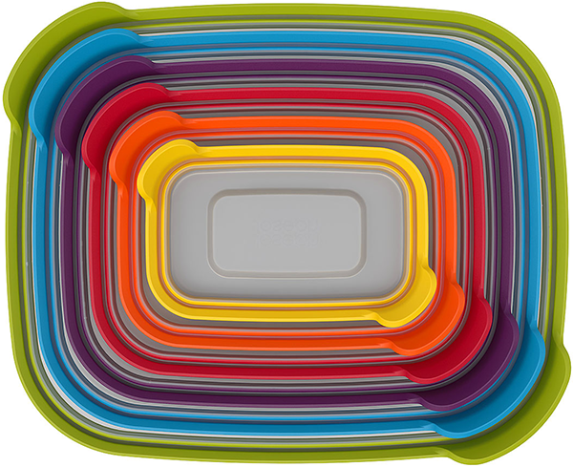
Nesting

Slide 25

The pipe operator

Slide 26
The %>% Operator
The “pipe” or “then” operator which allows us to pass data more easily between functions.
summarise(group_by(mtcars, cyl, am), MPG = mean(mpg)) ... # is the same as mtcars %>% group_by(cyl, am) %>% summarise(MPG = mean(mpg))
Introduction to R – Women in Data 2017

Slide 27
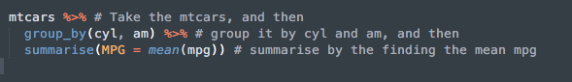
The %>% Operator
We are no longer giving the dataset name as the first argument to the group_by and summarise functions
We can easily pipe data through lots of functions in one block of code (easier to read)
Introduction to R – Women in Data 2017

Slide 28
The %>% Operator
> mtcars %>% select(mpg, wt, cyl, am, gear) %>% filter(am == 0) %>% group_by(cyl) %>% summarise(mean.mpg = mean(mpg)) Source: local data frame [3 x 2] cyl mean.mpg (dbl) (dbl) 1 4 22.900 2 6 19.125 3 8 15.050
Introduction to R – Women in Data 2017

Slide 29
Exercise 4
 | Use the %>% operator to write the following steps using airquality: Drop the Solar.R column Group by the Month Order by descending Wind values Keep only the observations where Wind > 15 Find the maximum Ozone value for each Month
Introduction to R – Women in Data 2017

Slide 30
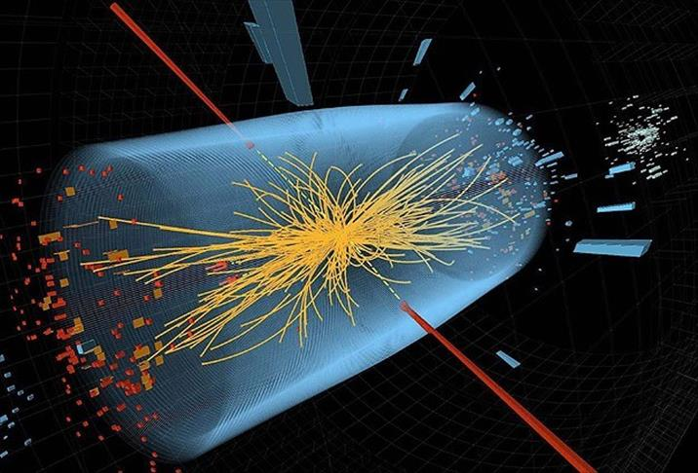
Data visualisation
Introduction to R – Women in Data 2017

Slide 31
Basic principles
ggplot2 package
Gramar of graphics:
Create a plot by adding elements (layers)
2 functions: qplot and ggplot
qplot makes a number of assumptions about what you are trying to plot
Histogram (only x axis given and of course data):
> qplot (x= mpg, data = mtcars)
Introduction to R – Women in Data 2017

Slide 32
Scatter Plot
Title, Labels and Range
>qplot(x = Sepal.Length,
y = Petal.Length,
data = iris,
main = 'Petal lenght as a function of sepal
length \n for different species of iris plant',
xlab = 'Sepal Length (cm)',
ylab = 'Petal Lenght (cm)',
xlim = c(3, 8),
ylim = c(0, 7))
Introduction to R – Women in Data 2017

Slide 33
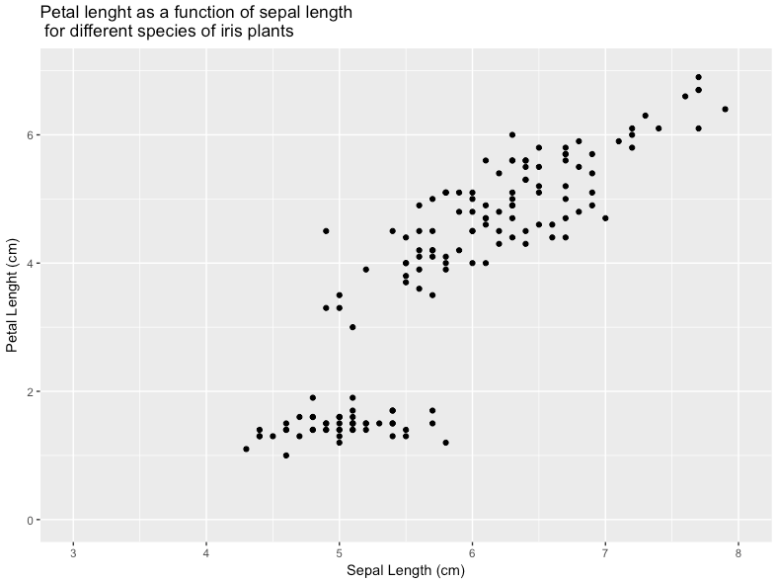
A simple scatterplot with qplot
Introduction to R – Women in Data 2017

Slide 34
Mapping (size, shape, colour)
qplot(x = Sepal.Length,
y = Petal.Length,
data = iris,
main = 'Petal lenght as a function of sepal
length \n for different species of iris plant',
xlab = 'Sepal Length (cm)',
ylab = 'Petal Lenght (cm)',
xlim = c(3, 8),
ylim = c(0, 7),
colour = Species,
shape = Species)
Introduction to R – Women in Data 2017

Slide 35
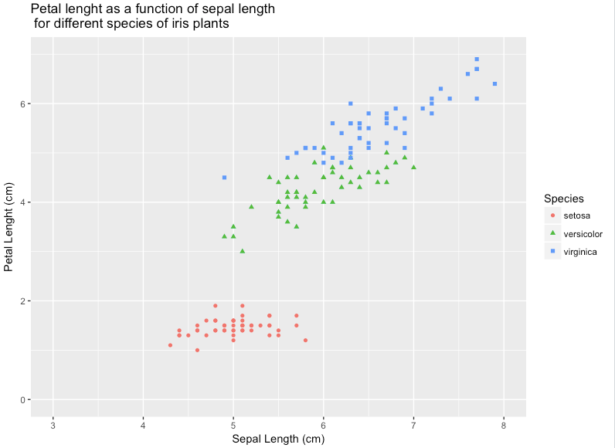
Mapping (shape, colour)
Introduction to R – Women in Data 2017

Slide 36
Mapping (choose the colour)
qplot(x = Sepal.Length,
y = Petal.Length,
data = iris,
main = 'Petal lenght as a function of sepal
length \n for different species of iris plant',
xlab = 'Sepal Length (cm)',
ylab = 'Petal Lenght (cm)',
xlim = c(3, 8),
ylim = c(0, 7),
colour = I(’red'),
shape = Species)
Introduction to R – Women in Data 2017

Slide 37
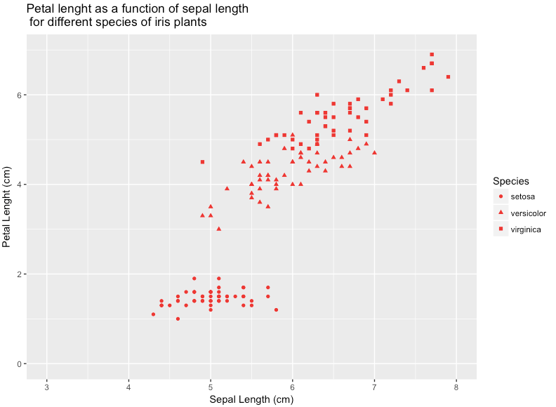
Mapping (choose the colour)
Introduction to R – Women in Data 2017

Slide 38
Exercise 5
 | Create a plot of Ozone against Wind from airquality. Ensure that the plot has appropriate titles and axis labels Ensure that the Wind axis begins at zero Create a histogram of wt from mtcars

Slide 39
Geometries (bar chart)
It is usually simpler to modify the data:
>library(dplyr)
>iris_mean <- iris %>%
group_by(Species) %>%
summarize(mean.Length = mean(Sepal.Length))
> qplot(x= Species, y= mean.Length, data = iris_mean ) +
geom_bar(stat="identity", fill = "#9e6b9b") +
xlab("Species") +
ylab("Maen Sepal Length (cm)")
Introduction to R – Women in Data 2017

Slide 40
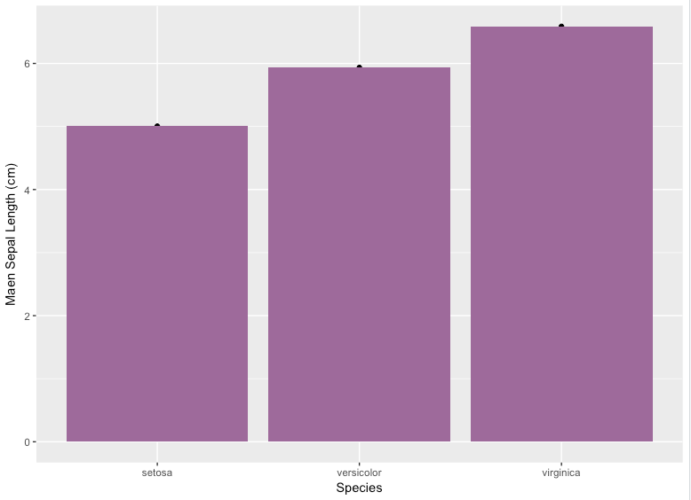
Geometries (bar chart)
Introduction to R – Women in Data 2017

Slide 41
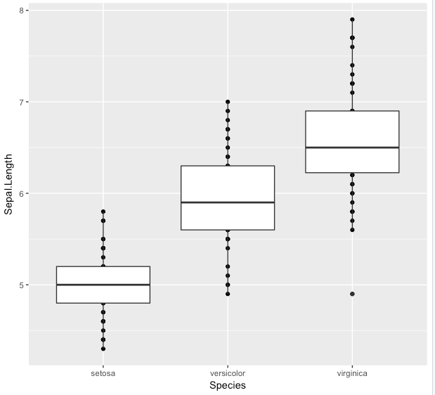
Geometries (box plot)
> qplot(x= Species, y= Sepal.Length, data = iris ) +
geom_boxplot()
Introduction to R – Women in Data 2017

Slide 42
Geometries
> grep(pattern="^geom", x=objects("package:ggplot2"),value =T)
[1] "geom_abline" "geom_area" "geom_bar"
[4] "geom_bin2d" "geom_blank" "geom_boxplot"
[7] "geom_col" "geom_contour" "geom_count"
[10] "geom_crossbar" "geom_curve" "geom_density"
[13] "geom_density_2d" "geom_density2d" "geom_dotplot"
[16] "geom_errorbar" "geom_errorbarh" "geom_freqpoly"
[19] "geom_hex" "geom_histogram" "geom_hline"
[22] "geom_jitter" "geom_label" "geom_line"
[25] "geom_linerange" "geom_map" "geom_path"
. . .
[28] "geom_point"
[43] "geom_violin" "geom_vline"
Introduction to R – Women in Data 2017

Slide 43

Simple statistics

Slide 44
Statistical models
Within R, we can fit a number of statistical models to our data. Some of the more common model fitting functions can be found in the following table:
Function | Model | Package
aov | Analysis of Variance | stats
lm | Linear regression | stats
glm | Generalised linear model | stats
gam | Generalised additive model | gam
lme | Linear mixed effects model | nlme
nls | Non-linear least squares regression | Stats
nlme | Non-linear mixed effects model | nlme
Introduction to R – Women in Data 2017

Slide 45
Linear model (formula)
R Formula | Model | Actual Model Formula
Y ~ 1 | Y against intercept | Y = α + ε
Y ~ X | Y against X + intercept | Y = α + βX + ε
log(Y) ~ X | log(Y) against X + intercept | log(Y) = α + βX + ε
Y ~ X – 1 | Y against X (no intercept) | Y = αX + ε
Y ~ X + Z | Y against X and Z + intercept | Y = α + βX + γZ + ε
Y ~ . | Y against X + ... + intercept | Y = α + βX + ... + ε

Slide 46
Linear model
> # Fit a model of E(MPG) = a + b * Weight
> mpgLm <- lm(mpg ~ wt, data = mtcars)
> #check what is in the linear model mpgLm
> names(mpgLm)
Function | Description
resid | Extract residuals from a model object
plot | Create summary or diagnostic plots for an object
predict | Create predicted values from a model object
fitted | Extract fitted values from a model object
update | Implement specified changes to a model object
confint | Computes confidence intervals for parameters of a model object
Introduction to R – Women in Data 2017

Slide 47
Further Reading and R events
R in 24 Hours
https://www.amazon.co.uk/24-Hours-Sams-Teach-Yourself/dp/0672338483
World Wide Web
London R
www.londonr.org
EARL
http://www.earlconf.com
Introduction to R – Women in Data 2017

